Slide 1
GoFigr Open Lab!
Maciej Pacula
Founder
https://gofigr.io
April 8, 2026

Slide 2
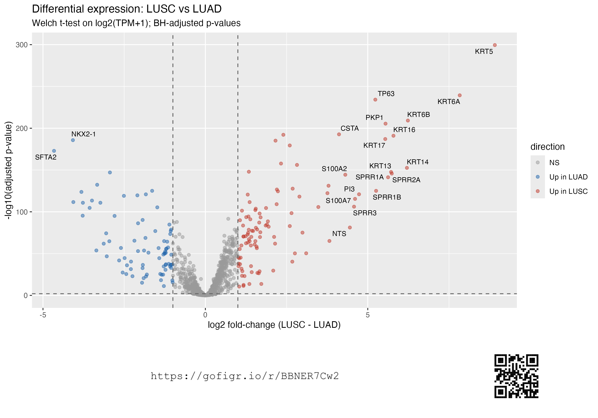
What is this volcano plot showing, exactly?
Does it include smokers?
Which version of the data did we use?
Can you re-do with our corporate colors? 🫠

Slide 3
Today: TCGA analysis with GoFigr
GoFigr setup
TCGA download
LUAD vs LUSC differential expression in R
Follow-up analysis in Python (Jupyter)
Clean Room – easy interactive reproducibility!
Stories: turn figures into an AI-generated slide deck with full provenance
… and update to latest figures with a click of a button!
Free stuff
Code and slides from today: https://github.com/GoFigr/examples
GoFigr signup at https://app.gofigr.io/register
Also send me a note at maciej@gofigr.io for an upgrade
Documentation at https://docs.gofigr.io/

Slide 4
Thank you!
Please visit https://gofigr.io for example figures and demo videos
Feel free to email me (maciej@gofigr.io) with any questions whatsoever

Slide 5
Supplemental

Slide 6


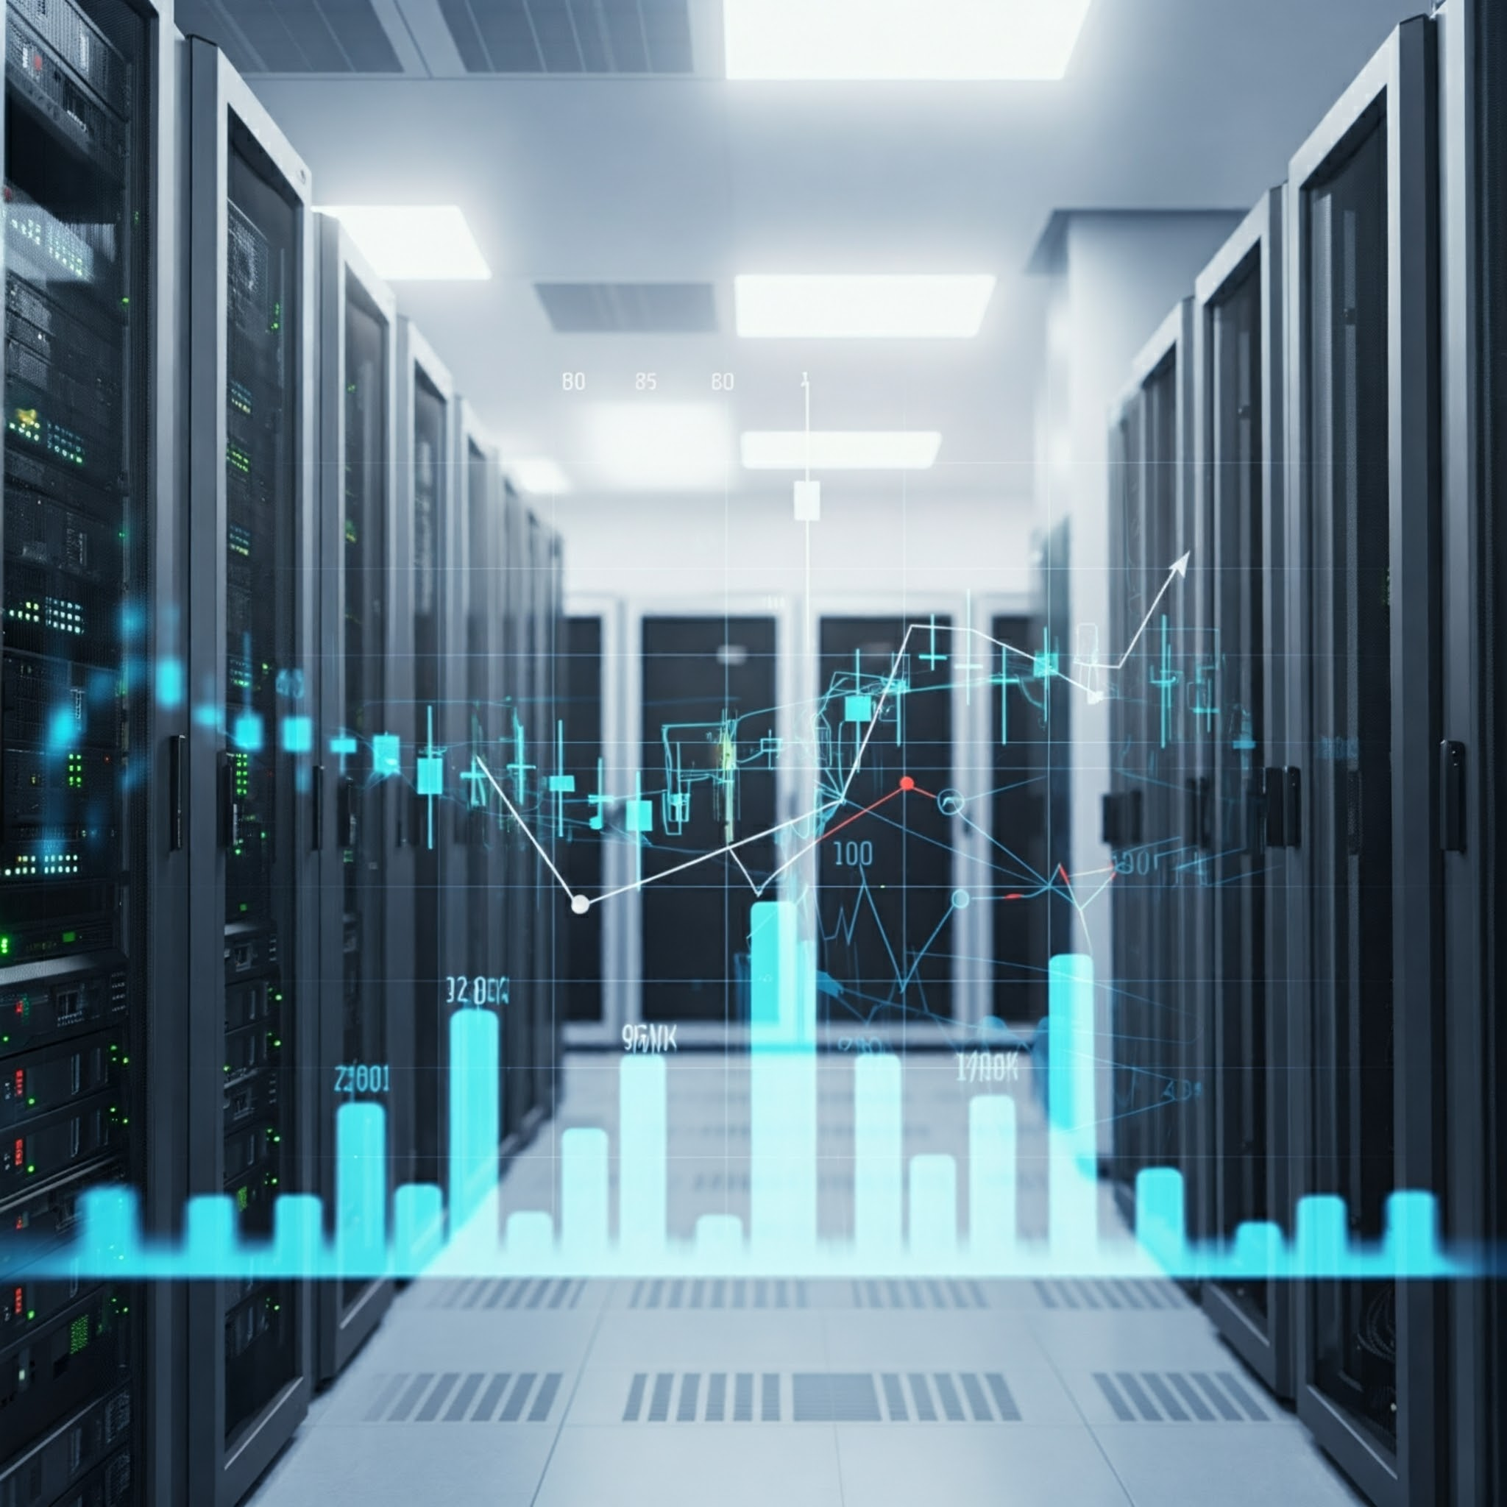








GoFigr: automatic provenance
The GoFigr.io portal
Real-time figure capture
Every figure, every revision, over the lifetime of your company
Reproducible: captures code and other context
Full traceability to author, data & source
Discoverable: Search and indexing
Figures
+
Data
+
Environment
+
Code

